Slide 1

VIRTUAL APPLIED DATA SCIENCE TRAINING INSTITUTE
April 1, 2022
Module 3b: Logistic Regression and Summary
Paul Kolm, PhD Associate Director Center for Biostatistics, Informatics and Data Science MedStar Health Research Institute BERD-CTSA (Georgetown-Howard)

Slide 2
Linear regression (GLM)
Dependent variable (outcome) is continuous and normally distributed.
y = b₀ + b₁X₁ + b₂X₂ + . . .
Regression coefficients (b) are change in y for every unit change in X.
R² is proportion of variance in y accounted for by X(s).

Slide 3
Binary logistic regression: generalized linear model
Outcome is dichotomous (dead/alive; yes/no)
Odds of outcome: p/(1-p)
Ln(p/(1-p)) = β₀ + β₁X₁ (logit)
Change in log odds of event with one-unit change in X (linearly increasing or decreasing).

Slide 4
Logistic Regression Curve
1.0
0.9
0.8
0.7
Probability
0.6
0.5
0.4
0.3
0.2
0.1
0.0
1
2
3
4
5
6
7
8
9
10
11
12
13
14
15
16
17
18
19
20
21
x
Notes:
The relationship between y_{i} and x_{i}’s is not a linear function.

Slide 5
Interpreting Logistic Regression (Logit) Coefficients
The slope coefficient from a logistic regression
β = the rate of change in the "log odds" of the event under study as X changes one unit
We want to know the change in the probability of the event as X changes.

Slide 6
Interpretation of a single continuous parameter
The sign (±) of β determines whether the log odds of y is increasing or decreasing for every 1-unit increase in x.
If β > 0, there is an increase in the log odds of y for every 1-unit increase in x.
If β < 0, there is a decrease in the log odds of y for every 1-unit increase in x.
If β = 0 there is no linear relationship between the log odds and x.
e^{β} is an odds ratio

Slide 7
Example
Age and coronary heart disease (CD): 0: No; 1: Yes

Slide 8
Logistic regression Number of obs = 33
LR chi2(1) = 11.32
Prob > chi2 = 0.0008
Log likelihood = -16.464684 Pseudo R2 = 0.2559
------------------------------------------------------------------------------
cvd | Coef. Std. Err. z P>|z| [95% Conf. Interval]
-------------+----------------------------------------------------------------
age | .0966777 .0361915 2.67 0.008 .0257437 .1676118
_cons | -5.164363 1.867668 -2.77 0.006 -8.824925 -1.503802
------------------------------------------------------------------------------
P(CVD | Age) = exp(-5.164363 + .0966777*age) /
(1 + exp(-5.164363 + .0966777*age) )

Slide 9
Logistic regression Number of obs = 33
LR chi2(1) = 11.32
Prob > chi2 = 0.0008
Log likelihood = -16.464684 Pseudo R2 = 0.2559
------------------------------------------------------------------------------
cvd | Odds Ratio Std. Err. z P>|z| [95% Conf. Interval]
-------------+----------------------------------------------------------------
age | 1.101505 .0398651 2.67 0.008 1.026078 1.182477
_cons | .0057167 .0106769 -2.77 0.006 .000147 .2222835
------------------------------------------------------------------------------
Exponentiated regression coefficient = odds ratio
For every 1-year increase in age, the odds of CVD increases by a factor of 1.1.
Or, there is a 10% increase in the odds of CVD for every 1-year increase in age.

Slide 10
Odds ratio from 2 x 2 table of events by independent groups.
 | Event yes | Event no | Total
Intervention | 46 | 54 | 100
Control | 37 | 63 | 100
Total | 83 | 117 | 200
Odds Ratio = ((46/100) / (1 – 46/100)) / ((37/100) / (1 – 37/100))
= 1.45
Odds Ratio = (46*63) / (37*54)
= 1.45
Event nearly 1.5 times more likely to occur in intervention group.
Statistical significance (odds ratio different from 1) obtained from chi-square test.
Assignment: Calculate the p value and 95% confidence interval of the odds ratio for the table above.

Slide 11
Multivariable logistic regression
More than one independent variable
Dichotomous, ordinal, nominal, continuous …
Interpretation of b_{i}
Increase in log-odds for a one unit increase in x_{i} with all the other x_{i}s constant
Measures association between x_{i} and log-odds adjusted for all other x_{i.}

Slide 12
PCI Inpatient-only 30-day readmission model
Variable | Odds Ratio | 95% CI | p value
Age (10 years) | 1.25 | 1.16 – 1.34 | < 0.001
Female | 1.18 | 0.99 – 1.40 | 0.069
Race
White | 1.00 | --------------------- | -----------
Black | 1.30 | 1.02 – 1.66 | 0.034
Other | 0.98 | 0.64 – 1.50 | 0.925
Elective | 0.59 | 0.50 – 0.70 | < 0.001
Transferred | 0.51 | 0.36 – 0.71 | < 0.001
Previous hosp. | 1.37 | 1.25 – 1.49 | < 0.001
Elixhauser count | 1.21 | 1.16 – 1.26 | < 0.001
CHF | 1.31 | 1.04 – 1.66 | 0.022
Renal failure | 1.23 | 0.96 – 1.58 | 0.100
c-index = 0.759 (0.742 – 0.776)

Slide 13
Evaluating logistic regression models
Discrimination – c-index (area under receiver operating characteristic curve). ▪ 0.5 = no discrimination ▪ ≥ 0.8 good discrimination ▪ 0.6 – 0.7 mediocre
Calibration – predicted probabilities = observed probabilities ▪ plot of observed probabilities with predicted probabilities ▪ calibration slope of 1.0.

Slide 14
Calibration plot for PCI Inpatient-only model
.6
.5
.4
Observed proportion readmitted
.3
.2
.1
0
1
2
3
4
5
Quintiles of predicted readmission

Slide 15
1
Bias-corrected calibration (slope = 0.97)
Ideal calibration (slope = 1.00)
.9
.8
.7
.6
Observed probability
.5
.4
.3
.2
.1
0
0
.1
.2
.3
.4
.5
.6
.7
.8
.9
1
Predicted probability

Slide 16
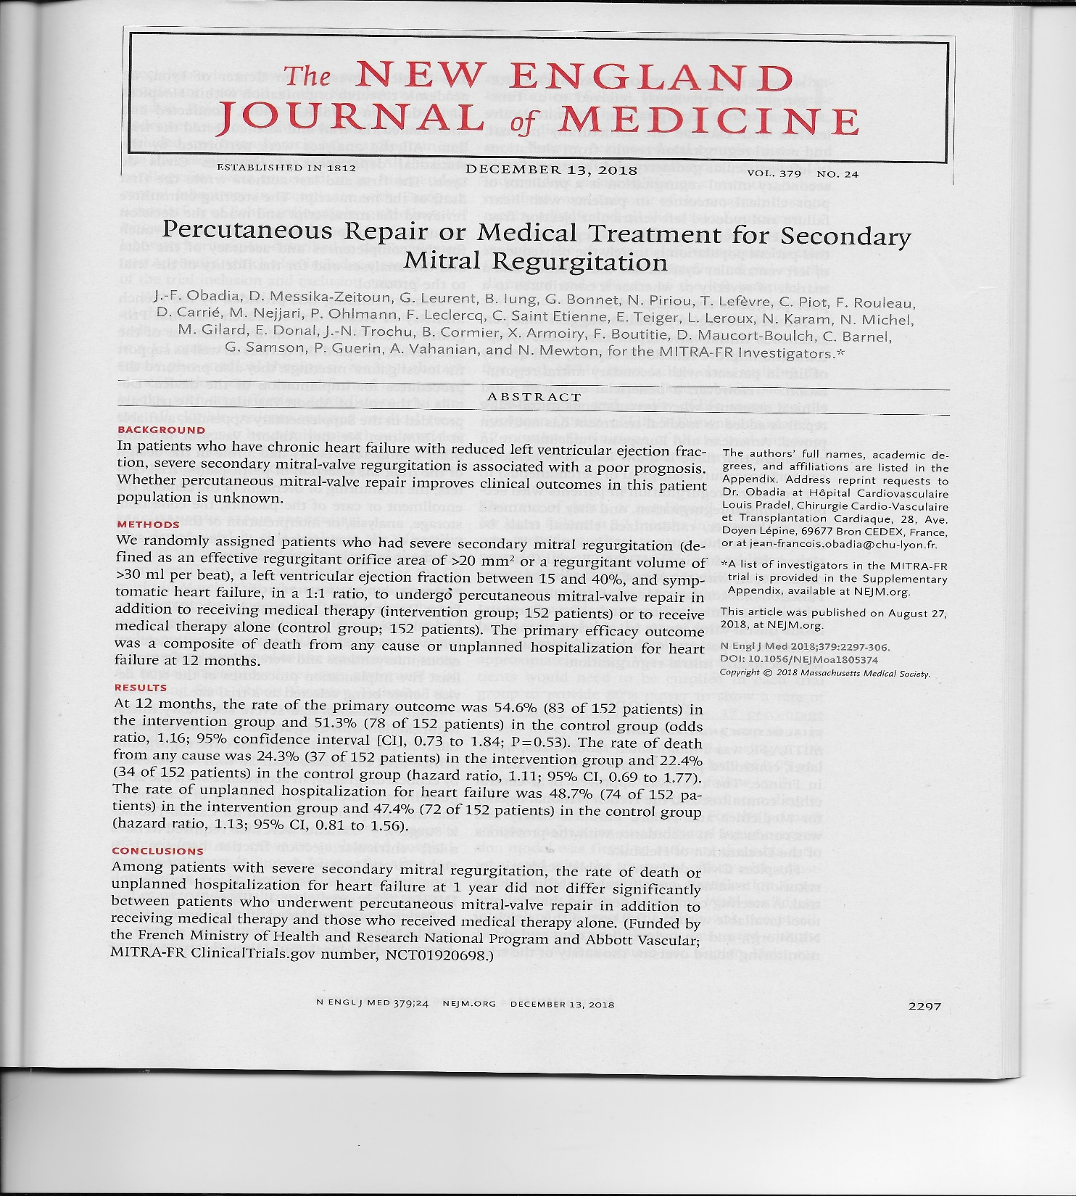

Slide 17
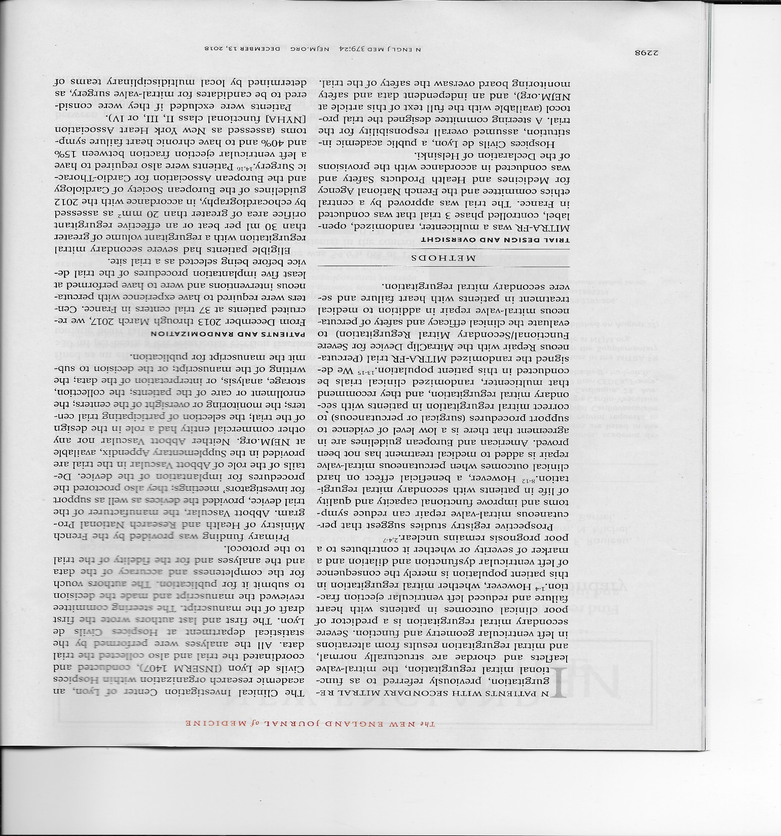

Slide 18
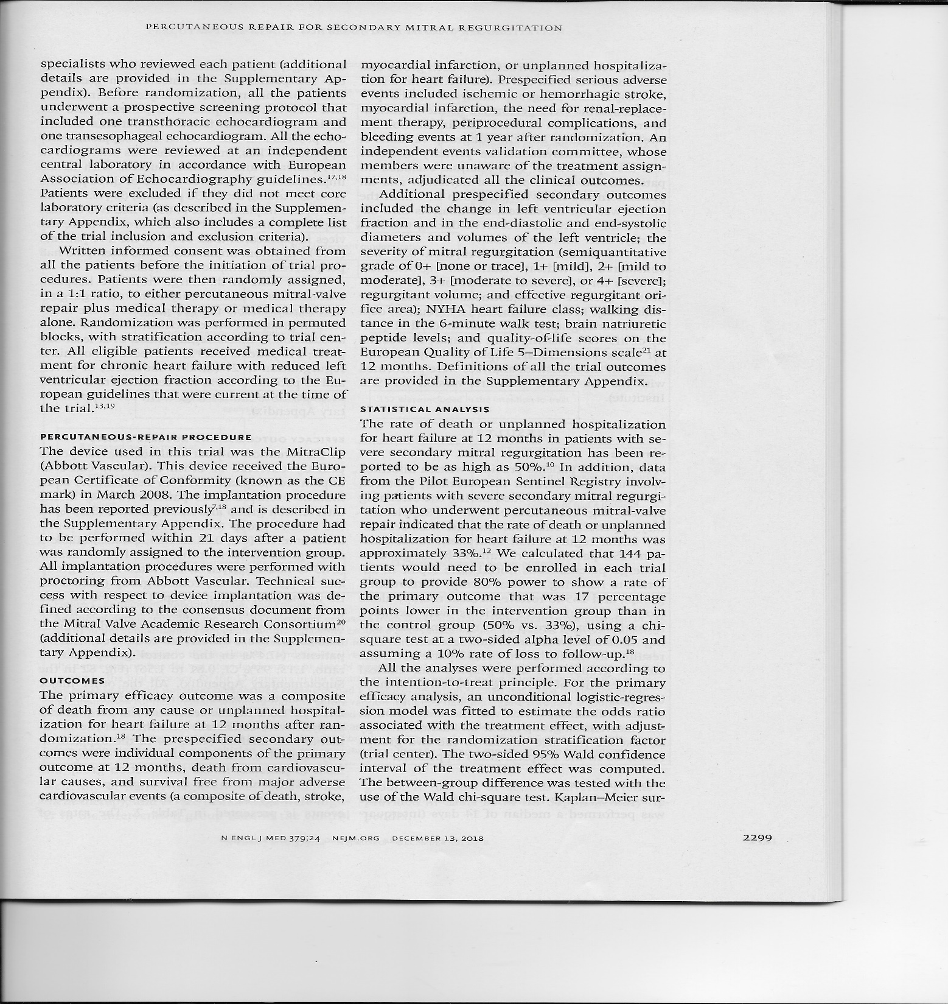

Slide 19
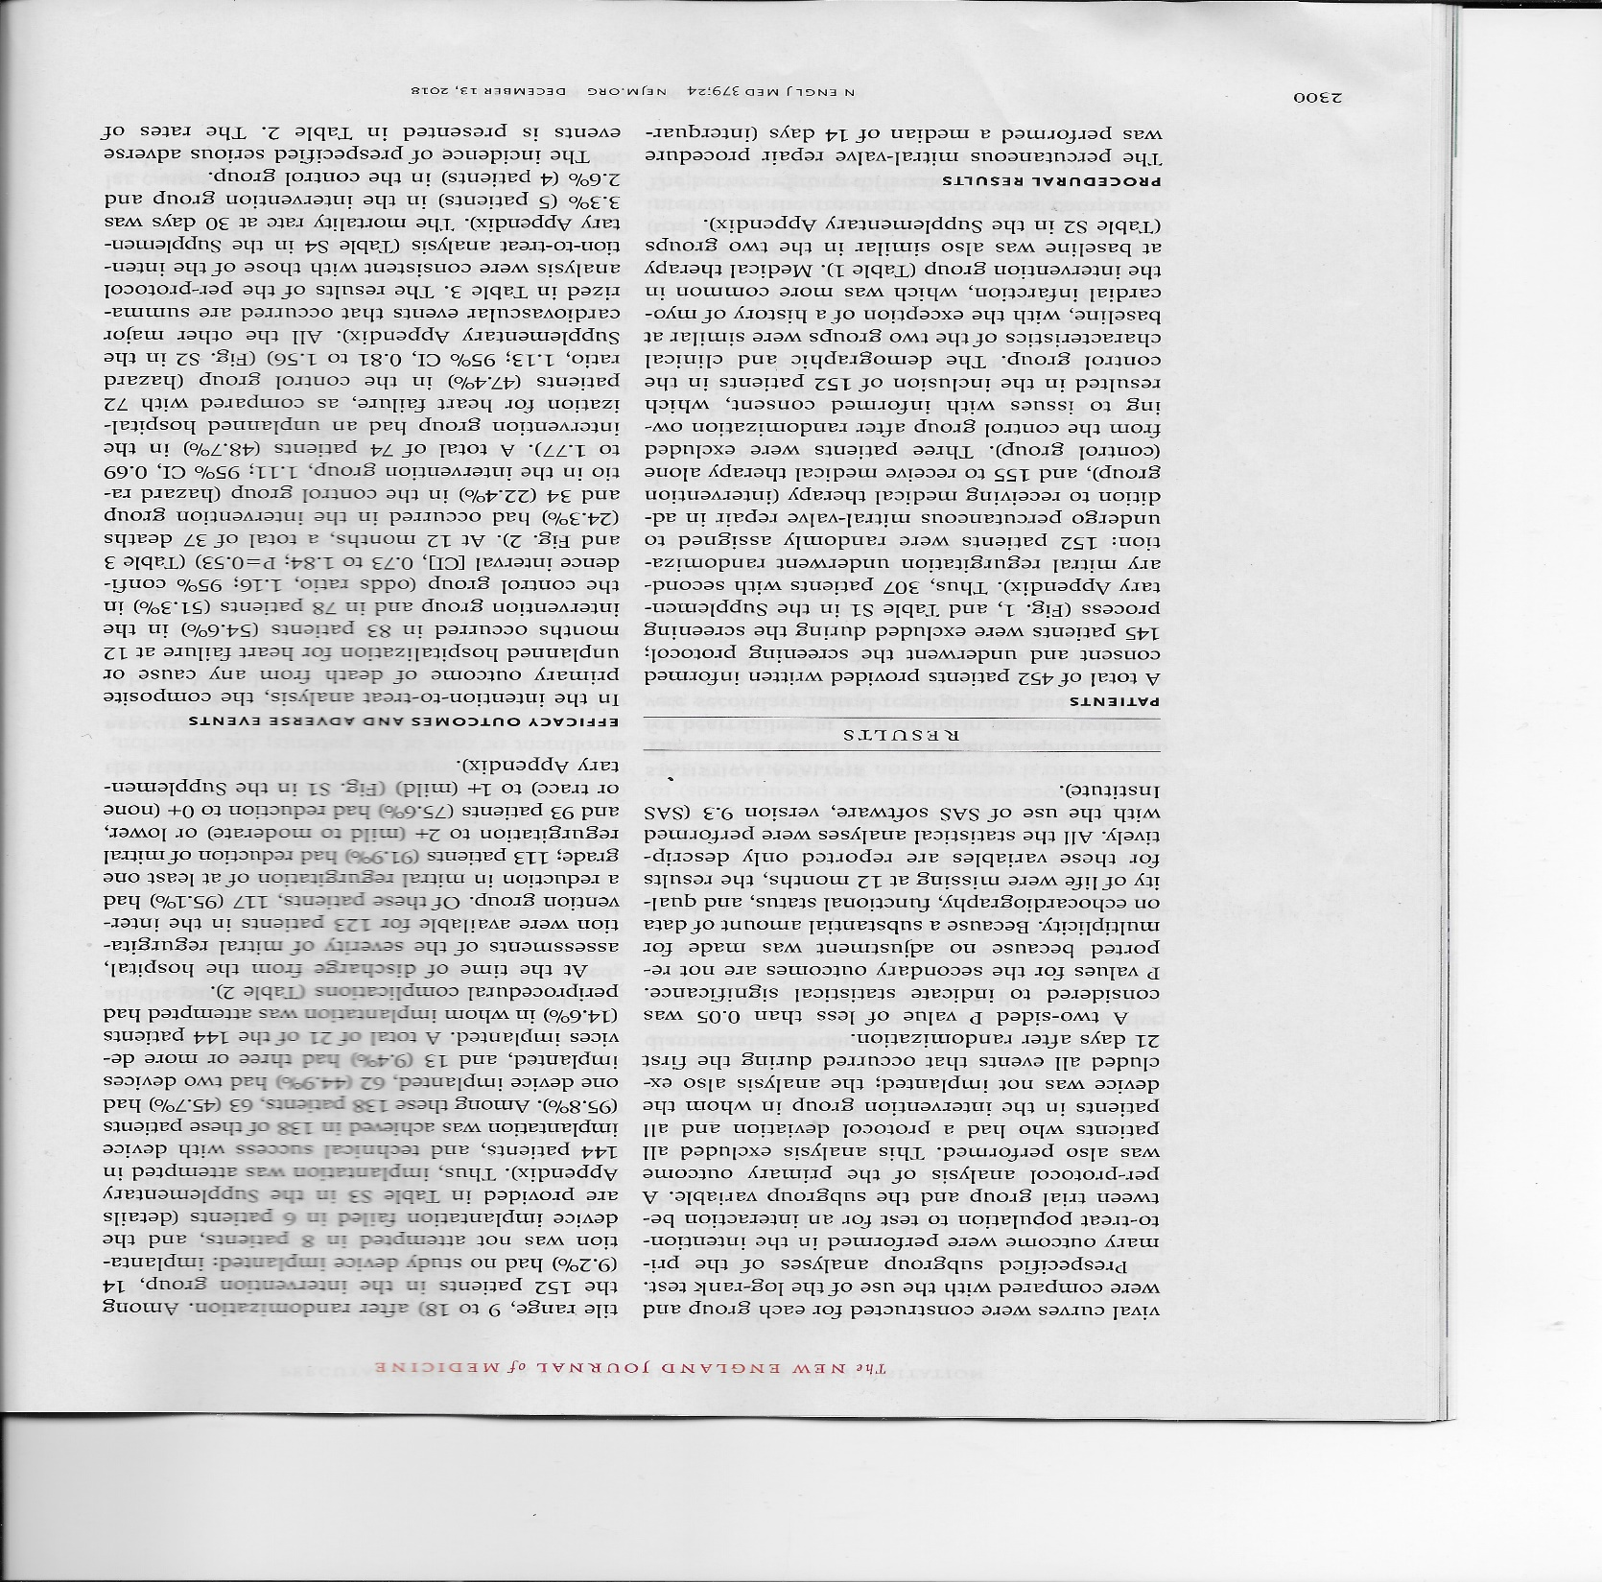

Slide 20
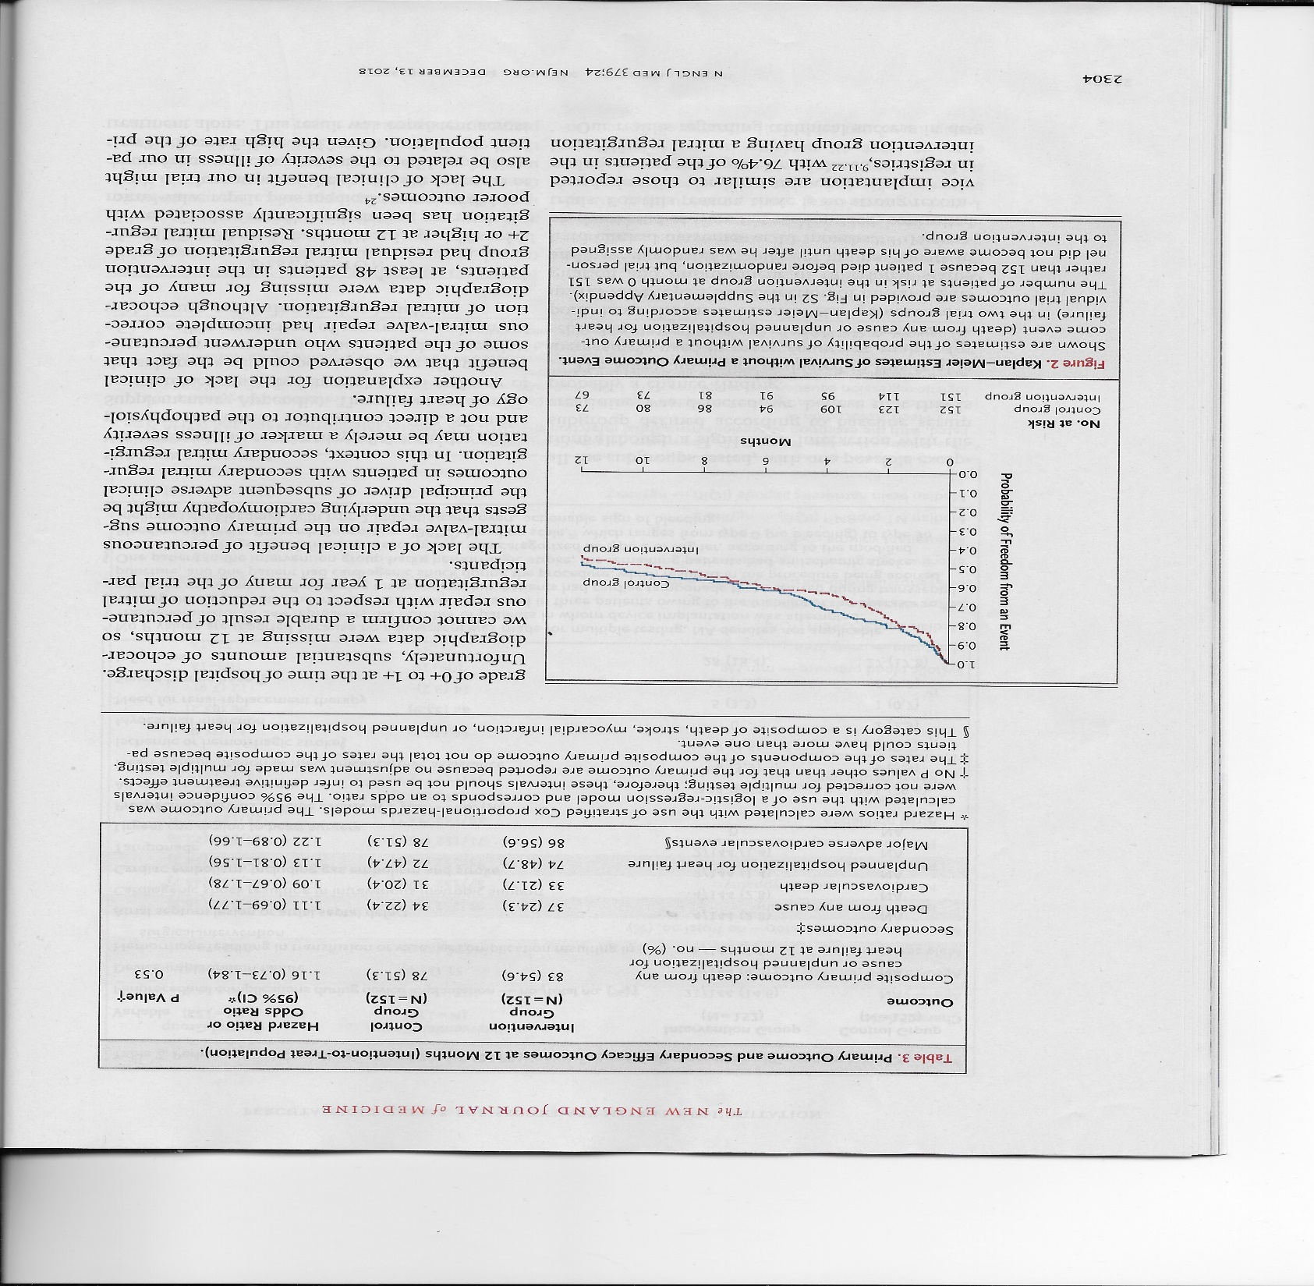

Slide 21
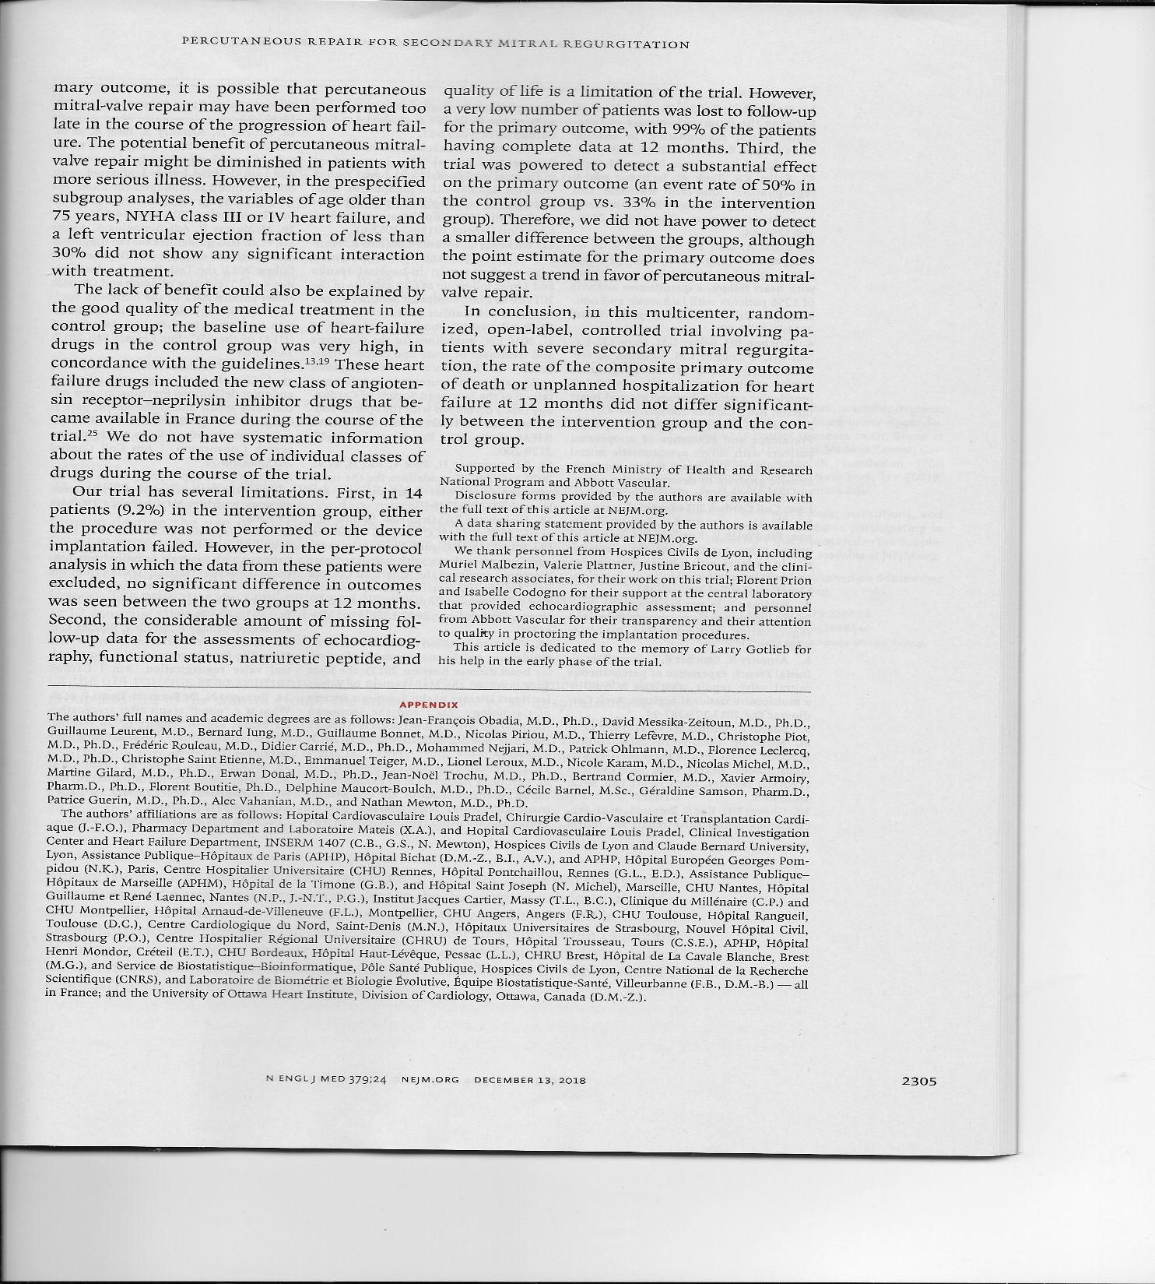
In conclusion, . . . . we found no evidence of a difference between the intervention and control group because we overestimated the effect size and were thus underpowered to detect any realistic difference.
In addition, we may have been wrong about the intervention decreasing death or unplanned hospitalization.
Powered on wrong statistical test.
Inappropriate statistical test – followed by the appropriate one.
Inappropriate conclusion.

Slide 22
Extreme values
Variable | Odds ratio | Lower 95% CI | Upper 95% CI | p value
Quarter | 1.410 | 0.849 | 2.344 | 0.185
Intervention year 1 | 0.253 | 0.035 | 1.834 | 0.174
Intervention year 2 | 0.010 | 2.60 x 10⁻⁵ | 3.779 | 0.129
Age (10 year increments) | 0.400 | 0.128 | 1.248 | 0.115
Female | 22.750 | 1.772 | 292.006 | 0.016
Black | 2.063 | 0.400 | 10.650 | 0.387
Other race | 3.17 x 10⁻⁷ | 5.20 x 10⁻⁸ | 1.94 x 10⁻⁶ | < 0.001
Medicaid | 1.59 x 10⁻⁸ | 2.60 x 10⁻¹³ | 9.78 x 10⁻⁴ | 0.001
Private insurance | 0.853 | 0.257 | 2.834 | 0.795
Self pay | 1.32 x 10⁻⁶ | 1.08 x 10⁻⁷ | 1.61 x 10⁻⁵ | < 0.001
Other insurance | 1.82 x 10⁻⁶ | 3.25 x 10⁻⁷ | 1.02 x 10⁻⁵ | < 0.001
Previous hospitalization | 1.633 | 0.871 | 3.059 | 0.126

Slide 23
Other issues
Categorization of continuous variables aids interpretation – but decreases power.
If relationship of outcome and continuous variable(s) is non-linear, interpretation of the odds ratio will be incorrect.
Model discrimination and calibration matter – if model is statistically significant, but c-index is less than .7, model is suspect (.5 is no discrimination)
More than 2 categories: Ordinal logistic regression Multinomial logistic regression

Slide 24
BREAK – 10 MINUTES

Slide 25
Statistics: Measurement of Uncertainty
Treatment differences
Individual patient variability
Demographics (age, sex, race, BMI)
Comorbidities / previous treatments
Measurement error (PROs, reading echos)
Missing data (ignorable vs. nonignorable)
Time of measurement (e.g., day/night blood pressure)
Medication adherence
Treatment cross-over
Cluster variability (hospitals, countries)
Random sampling variability (uncertainty due to chance)
Notes:
changed

Slide 26
Populations and samples
Population – everyone in the universe (of interest)
Sample – subset of the population of interest (random or not)
Is the sample representative of the population?
Research sample
Population
Notes:
changed

Slide 27
Bayesian and frequentist perspectives
Frequentist: Probability is the long-run frequency of random events over repeated sampling.
Bayesian: Probability is an index of confidence an investigator has about the occurrence of an event.
Frequentist: Data are random; population parameter is fixed.
Bayesian: Data are fixed; population parameter (e.g., mean) is random.

Slide 28
95% confidence intervals for dBP from hypothetical samples (n = 5)
Population mean dBP = 76
Sample Mean SEM LB UB 5666666666677777777778888888888999999
9012345678901234567890123456789012345
72 82 73 90 81 80 3 70 89 (-----x------------)
89 90 77 80 82 84 3 77 91 x(-------------)
95 91 73 65 72 79 6 63 95 (------------x------------------)
83 75 69 92 79 80 4 69 90 (------x-------------)
64 71 80 76 94 77 5 63 91 (------------x--------------)
63 73 61 73 66 67 2 60 74 (-------------) x
69 67 85 72 73 73 3 64 82 (-----------x-----)
62 91 79 89 62 77 6 59 94 (----------------x-----------------)
81 76 91 77 63 78 5 65 90 (----------x-------------)
69 74 91 73 66 75 4 63 87 (------------x----------)
The sample means constitute a sampling distribution (distribution of statistics).
The standard error of the mean (SEM) quantifies variability of the sampling distribution.
95% CI is equal to the mean ± 2 x SEM (2 is standard deviation units of the normal distribution).
The mean of the sampling distribution will approximate the population mean.
The larger the sample size, the smaller the standard error.

Slide 29
Statistical decision making
Decision to reject the null hypothesis (or fail to reject) based on a probability of making a wrong decision – assuming the null hypothesis is true.
Type I error (alpha): probability of rejecting the null hypothesis when it is true.
Type II error (beta): probability of failing to reject the null hypothesis when it is false.

Slide 30
p values
What p values are: It is a preset level for rejecting the null hypothesis. On the same scale as a probability (0,1).
What p values are not: probability that the null hypothesis is false. probability that the alternative hypothesis is true. an index of importance or meaningfulness.
If p < 0.05 (or 0.01), reject the null hypothesis.
If p > 0.05, fail to reject the null hypothesis

Slide 31
Bayesian analysis
Prior belief (event, condition, diagnosis).
Get new information (data).
Revise prior belief with posterior (new) belief.

Slide 32
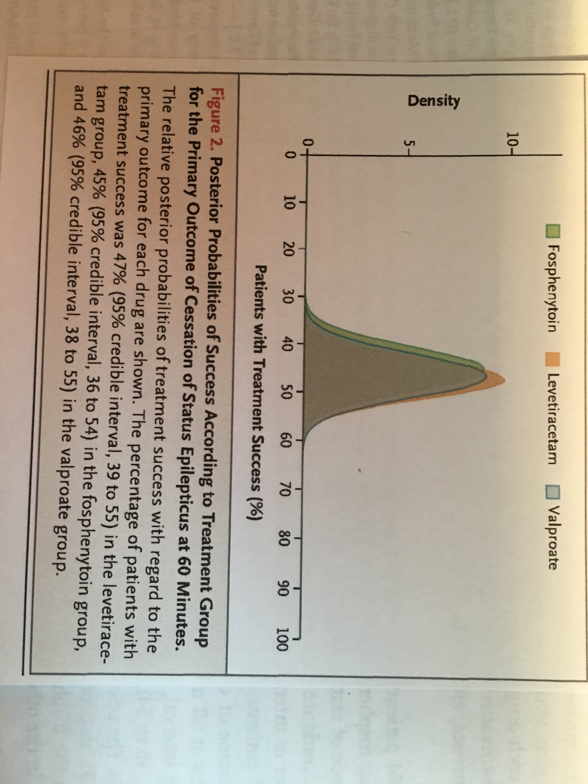
In this prospective, randomized, double-blind, adaptive comparative-effectiveness trial involving patients with benzodiazepine-refractory status epilepticus, we found no significant difference in the percentage of patients with seizure cessation among the levetiracetam group, fosphenytoin group, and valproate group.
Treatment success and 95% Credible Interval
Levetiracetam: 47% (39% - 55%)
Fosphenytoin: 45% (36% - 54%)
Valproate: 46% (38% - 55%)

Slide 33
20 25 30 35 40 45 50 55 60 65 70 75 80
Patients with treatment success (%)
2.5%
If one drug had been superior to the other 2 with 97.5% confidence that the difference was 65% effective compared to 50% effective, the results would have been as depicted above.

Slide 34
Bayesian CI:
95% credible interval: 95% probability that the interval includes the population parameter.
Frequentist CI:
95% confidence interval: over repeated sampling, the interval will include the population parameter 95% of the time.

Slide 35
Statistical Methods
Parametric – assume some theoretical distribution for data / test statistic
Non-parametric – no assumptions about distribution

Slide 36
Regression models
Method | Model | Result
Linear Regression | Y= α + βX | Rate of change
Logistic Regression | logit (p_{i}) = α + βX | Odds ratio
Survival Analysis | H(t) = h_{o}(t) exp(α + βX) = h_{o}(t) e ^{(α + βX)} | Hazard ratio

Slide 37
Nonparametric statistics
Distribution-free
No assumption is made about the distribution of the outcome variable.
Mann-Whitney U test (t-test)
Wilcoxon matched-pairs signed-ranks test
Kruskal-Wallis (one-way analysis of variance)
Spearman / Kendall correlation
McNemar test for correlated proportions

Slide 38
Nonparametric statistics
Bootstrap – randomly select an observation from sample data with replacement.
Jackknife – leave-out-one

Slide 39
Multiplicity
Large number of hypothesis tests.
Inflates the alpha error rate.
Approximately number of tests times alpha error.
10 x 0.05 = 0.5
Performing a large number of statistical tests can result in finding significance just by chance.

Slide 40
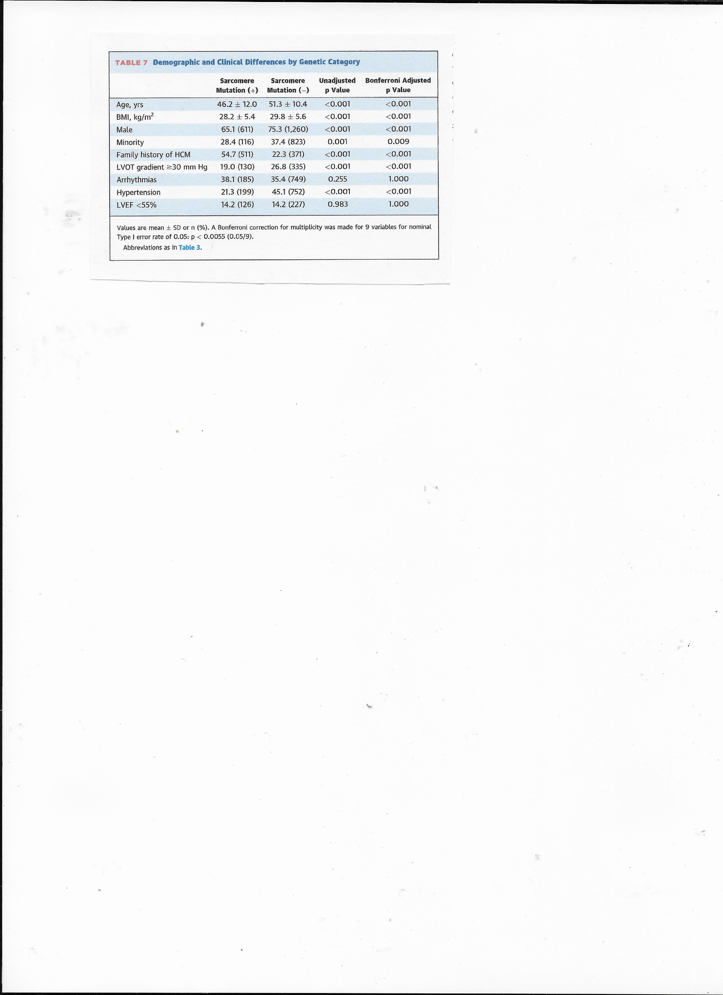
Alpha error rate adjustment for multiple tests.

Slide 41
Standardized differences
Standardized difference of means:
X_{SD} = (X₁ – X₂) / √(variance₁ + variance₂) / 2) variance = standard deviation squared
Standardized difference of proportions:
P_{SD} = (P₁ – P₂) / √(variance₁ + variance₂) / 2) variance = P₁*(1 – P₁); P₂*(1 – P₂)

Slide 42
Selected standardized differences and corresponding percent non-overlap.
Standardized difference | Percent non-overlap
0.0 | 0.0
0.1 | 7.7
0.2 | 14.8
0.3 | 21.3
0.4 | 27.4
0.5 | 33.0
0.6 | 38.2
0.7 | 43.0
0.8 | 47.4
0.9 | 51.6
1.0 | 55.4

Slide 43
Comparison of p values and standardized differences
 | Group 1 | Group 2
Variable | Mean ± SD / Proportion | Mean ± SD / Proportion | p value | STZD difference
Age (yrs) | 64.7 ± 10.0 n = 3,000 | 64.1 ± 10.0 n = 3,000 | 0.020 | 0.060
 | 60.5 ± 10.0 n = 30 | 64.1 ± 10.0 n = 30 | 0.169 | -0.360
DM (%) | 150 (5.0%) n = 3,000 | 200 (6.7%) n = 3,000 | 0.006 | -0.072
 | 2 (6.7%) n = 30 | 5 (16.7%) n = 30 | 0.228 | -0.315

Slide 44
Planning and executing a research study
Research question (specific aims)
Study design
Relevant data (outcome, demographics, covariates)
Data collection methods (storage, security)
Time-lines if prospective study

Slide 45
Data analysis
Data checking / cleaning (outliers, out-of-range) e.g, 0.1 – 2.0 acceptable range of values value of 1354 (omitted a decimal?)
Descriptive statistics
Primary and secondary analyses
Write up methods and results
Tables and graphs

Slide 46
Thank you!!
paul.kolm@medstar.net

